Slide 1
Segmentation
Customer
Unsupervised machine learning in Python

Slide 2
Context
Purpose
Understanding
customer behavior:
Attract and retain customers
Target coupons and sales
Increase web traffic and sales
Company leadership
Other staff whose goals will be affected by the project
Customers
Past trends may not indicate future trends
Additional variables outside the scope of this project
Stakeholders
Constraints

Slide 3
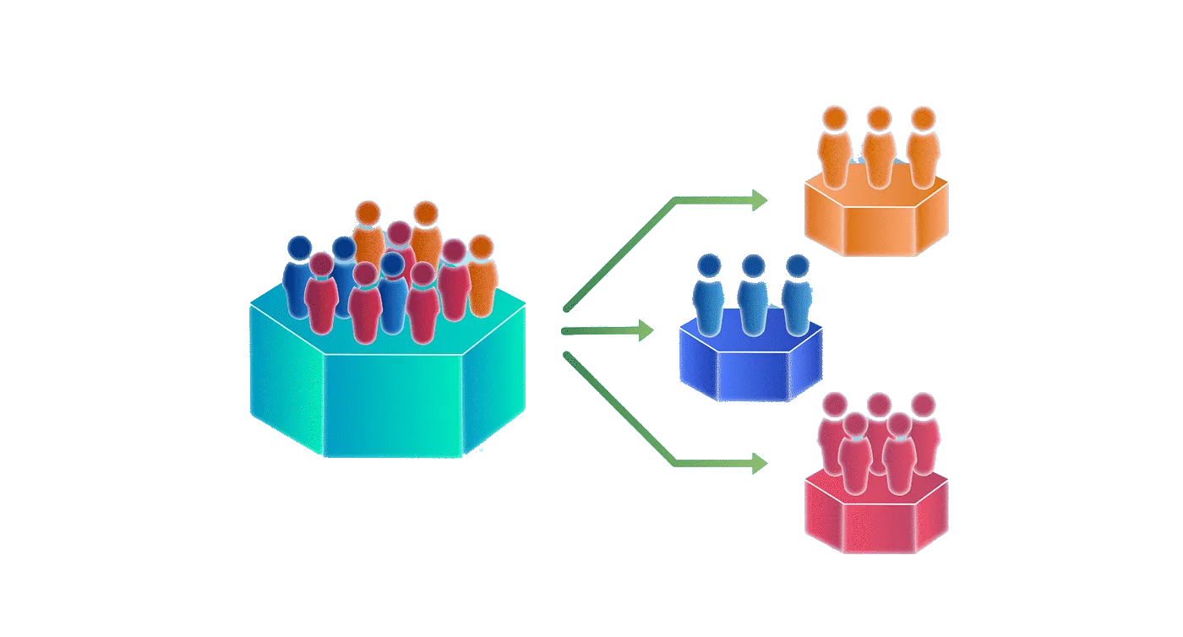
Problem Statement:
Grouping customers based on personal attributes and purchasing history can help companies understand their customers and aid in targeted marketing and other key business decisions.

Slide 4
About the data:
“Customer personality analysis” by Dr. Omar Romero-Hernandez, uploaded by Akash Patel
Csv file containing 2240 observations with 29 variables:
Demographics
Purchases
Discounts
Shopping habits
ID
Year_Birth
Education
Marital_Status
Income
Kidhome
Teenhome
Dt_customer: date enrolled
Recency: last purchase
Complain: 1=yes/2=no
Spent in the past 2 years:
MntWines: on wine
MntFruits: on fruit
MntMeatProducts: meat
MntFishProducts: fish
MntSweetProducts: sweets
MntGoldProds: gold
Customer participated in:
NumDealsPurchases: total discount purchases
AcceptedCmp1: 1st campaign
AcceptedCmp2: 2nd campaign
AcceptedCmp3: 3rd
AcceptedCmp4: 4th
AcceptedCmp5: 5th
Response: last campaign
Location of purchases:
NumWebPurchases
NumCatalogPurchases
NumStorePurchases
NumWebVisitsMonth

Slide 5


Data Wrangling
Problem: different formats
Problem: missing data
NaN
Dropped unusable categorical responses and combined extraneous categories into fewer, logical groups
Imputed missing values with mean value for the column
Problem: extra variables
Combined logical features like kidhome and teenhome to children

Slide 6
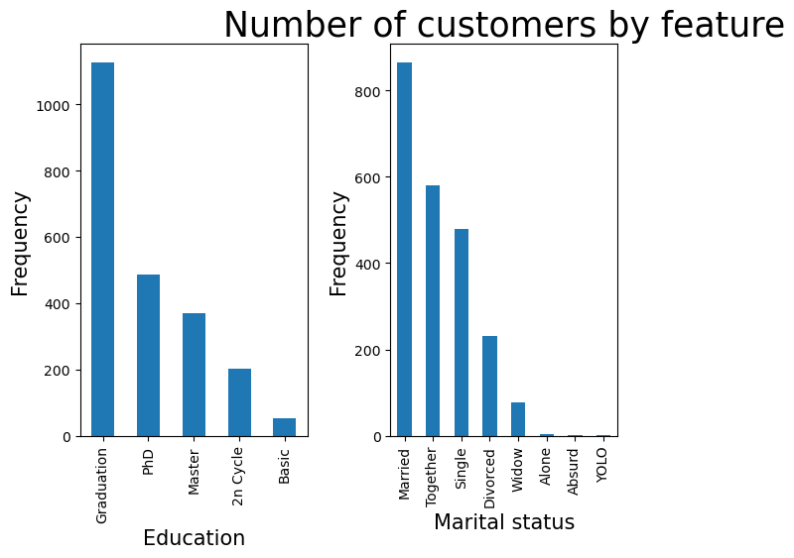
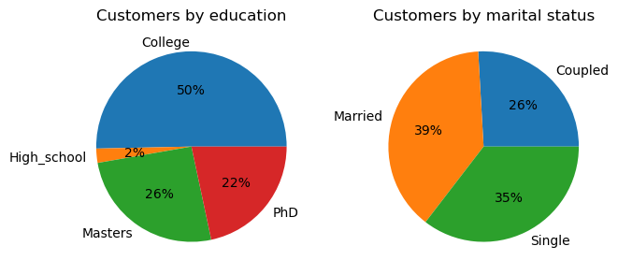
Exploratory Data Analysis

Slide 7
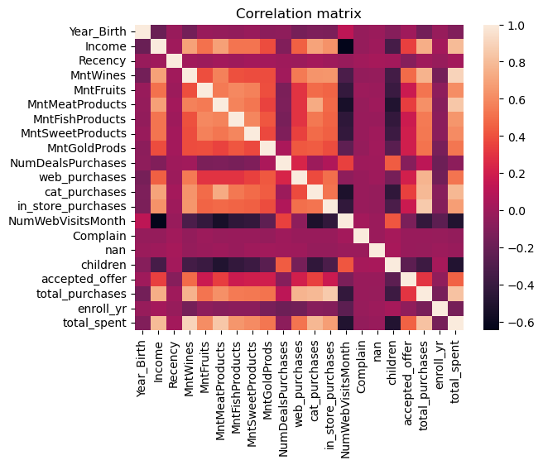
Exploratory Data Analysis

Slide 8
Exploratory Data Analysis
Key findings
Univariate analysis
Outliers
Examining rows with missing values show no significant different compared with other rows.
6
1
There are 3 customers whose birth years before 1940, all of which are around 1900.
Univariate distribution
Bivariate analysis
5
2
The distribution of each variable is fairly uniform with many features heavily right skewed.
No two variables appear to be so highly correlated as to either create cause for excitement or concern in modeling.
4
3
Distribution
Correlation matrix
Right skewed features suggest many customers purchase or participate minimally or not at all and less customers purchase or participate at higher levels.
High correlations seem to be between total purchases and in store purchases, total spent and wine purchases, and number of purchases and total spent.

Slide 9
Machine Learning Algorithms
K-means clustering
Optics
Hierarchical (agglomerative) clustering
DBSCAN
Gaussian mixture model

Slide 10
Refining Models
8
K-Means
38
Optics
Overall best number of clusters
2
2
Agglomerative
1
DBSCAN
2
GMM

Slide 11
Model Metrics
Model name | Cluster # | Other hyperparameters | Silhouette score
Agglomerative | 2 | Complete linkage, euclidean metric | 0.522831
 | 2 | Average linkage, euclidean metric | 0.522831
 | 2 | Average linkage, manhattan metric | 0.522831
 | 2 | Single linkage, manhattan metric | 0.522831
 | 3 | Single linkage, manhattan metric | 0.476398
 | 2 | Single linkage, cosine metric | 0.446398
K-Means | 2 | Lloyd algorithm | 0.474022
 | 2 | Elkan algorithm | 0.474022
 | 3 | Lloyd algorithm | 0.282738
 | 3 | Elkan algorithm | 0.282738
 | 5 | Lloyd algorithm | 0.062095

Slide 12
Model Metrics
Model name | Cluster # | Other hyperparameters | Silhouette score
GMM | 2 | Tied covariance | 0.456527
 | 2 | Full covariance | 0.401546
 | 3 | Tied covariance | 0.287145
 | 3 | Full covariance | 0.1668
DBSCAN | —------ | epsilon=10, p=2 | 0.446398
 | —------ | epsilon=10, p=1 | 0.446398
 | —------ | epsilon=8, p=2 | 0.443647
 | —------ | epsilon=9, p=2 | 0.438544
Optics | 3 | p=2 | -0.317792
 | 2 | p=2 | -0.320906
 | 3 | p=1 | -0.345548

Slide 13
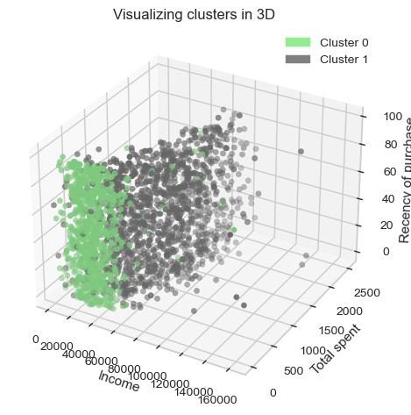
Visualizing Clusters

Slide 14
Conclusions from Clusters
Cluster 0
Cluster 1
$34,019
Cluster 1 customers have higher income,
on average.
$62,704
1.266
Cluster 0 customers are more likely to have at least one child (or teenager) at home.
0.76
17.4%
Customers in cluster 1 are more likely to have accepted a promotional offer.
60.9%
$95.83
Customers in cluster 0 have spent less on the company’s products than cluster 1 customers.
$911.29

Slide 15
Recommendations
For cluster 0:
For cluster 1:
the group that tends to purchase more items:
the group that has thus-far been purchasing less items:
The company may want to target this group when they are having sales or are pushing any initiatives toward customers who are more reliable buyers.
The company may want to examine this group to see whether they can increase sales within this set of their customers.

Slide 16
Additional Thoughts and Future Research
I would spend more time on additional recommendations.
I would like to examine other 3D modeling techniques
Because DBSCAN and Optics do not perform well with silhouette score:
I would try other metrics that might be more appropriate for comparing all models.
For more information or questions, contact Carrie-Cate Jenkins at ccsaidhi86@gmail.com

Slide 17
Thanks and Credits
Special thanks to Silvia Seceleanu for her guidance and support.
Credit to Springboard for curriculum and project ideas.
Slide template designed by Slidesgo school.

